Slide 1
MULTIMETER, OSCILLOSCOPE & SIGNAL GENERATOR
Presentation on
PRESENTATION BY-
MD. MARUF HASAN

Slide 2
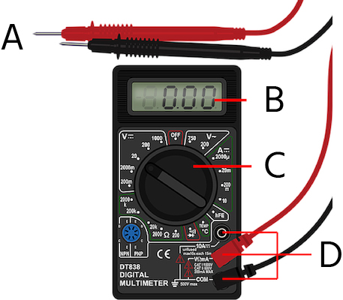
Multimeter
A multimeter is a measuring instrument that can measure multiple electrical properties.
A typical multimeter can measure voltage, resistance, and current.

Slide 3
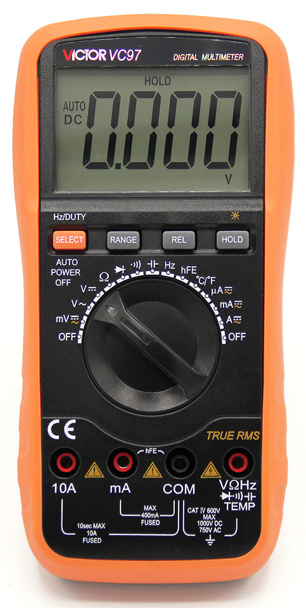
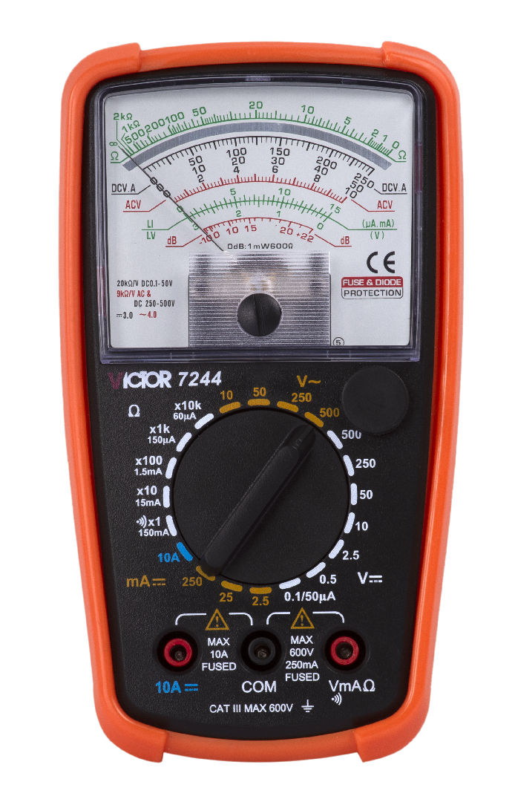
Types of Multimeter:
There are two types of Multimeter :
Analog Multimeter
Digital Multimeter
Analog Multimeter
Digital Multimeter

Slide 4
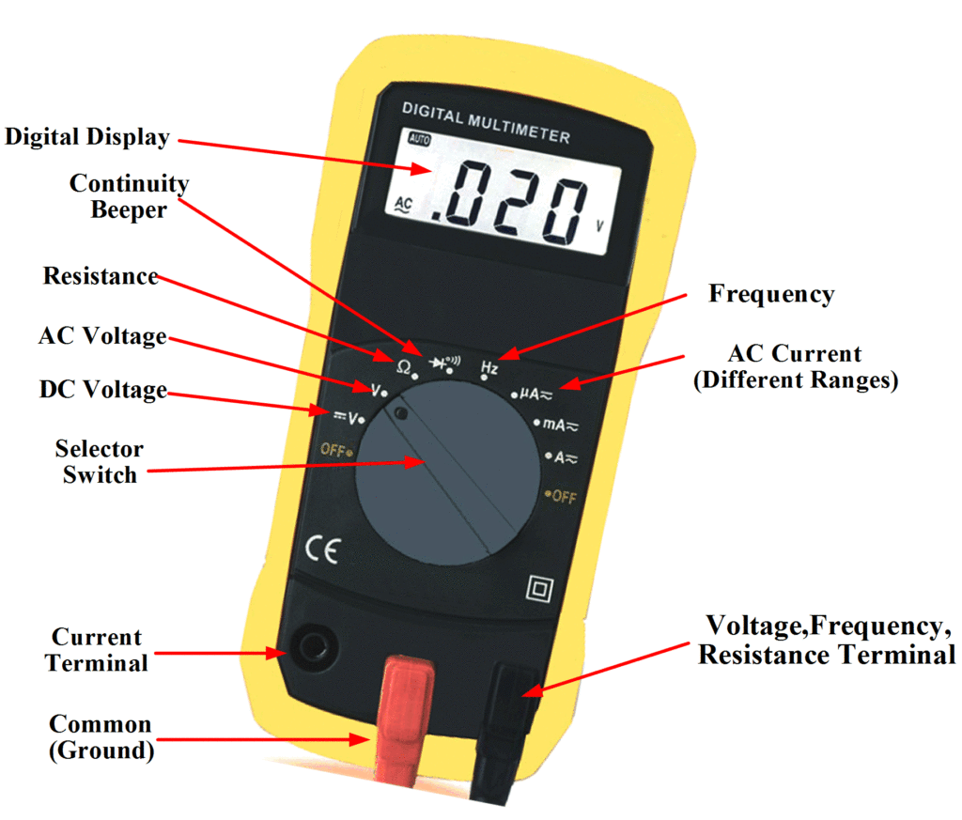
Parts of a Multimeter:
A digital multimeter consists of four main parts:
Screen: Used to display measurements.
Buttons: Used to select functions.
Dial or switch: Used to choose the type of measurement.
Jacks: Used to connect test leads.

Slide 5
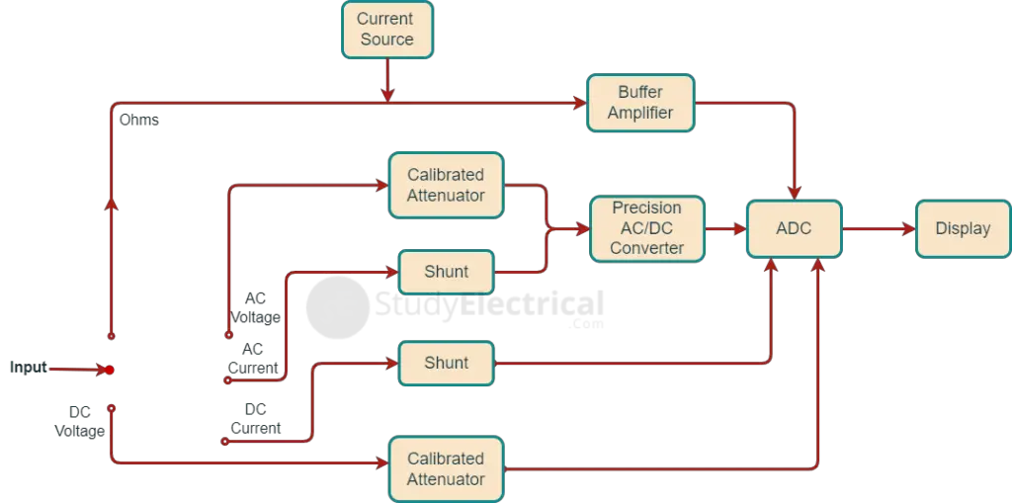
Working Principle of Digital Multimeter:
Block diagram of Digital Multimeter

Slide 6
How does the Multimeter work？
Here is an overview of how a multimeter generally works:
① Voltage Measurement: When measuring voltage, connect the multimeter in parallel to the circuit or component under test. In this mode, the multimeter acts as a high-resistance voltmeter. It uses a voltage divider circuit and an analog-to-digital converter to measure the voltage and display it on the screen.
② Current Measurement: When measuring current, Connect the multimeter in series to the circuit. In this mode, the multimeter acts as a high-resistance voltmeter. It uses a voltage divider circuit and an analog-to-digital converter to measure the voltage and display it on the screen.
③ Resistance Measurement: When measuring resistance, the multimeter makes a known small current flow through the component, measures the voltage drop across it, and then uses Ohm's law to calculate the resistance.
④ Diode Test: When testing a diode, the multimeter applies a small forward bias voltage and measures the resulting current. It detects the direction of current flow and displays the forward voltage drop across the diode, indicating its functionality.

Slide 7
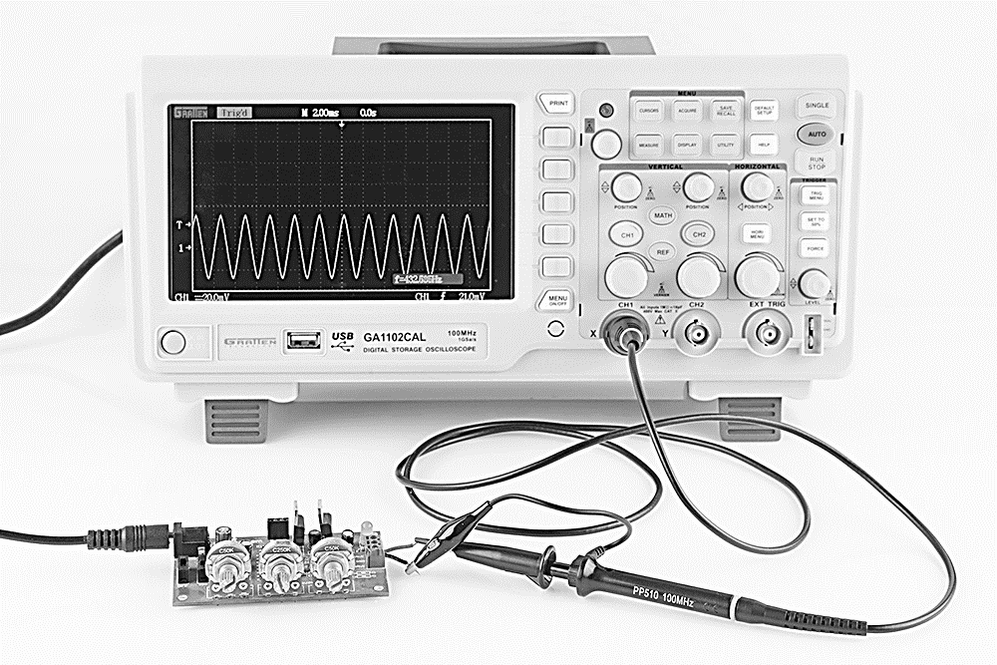
Oscilloscope
An oscilloscope is an electronic instrument that graphically displays electrical signals and shows how those signals change over time.

Slide 8
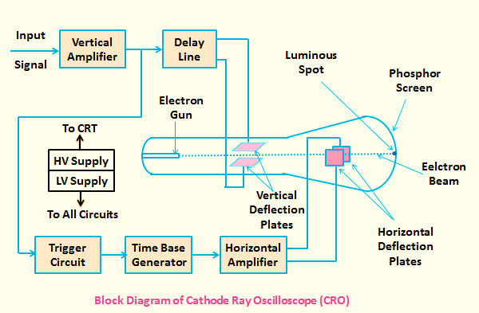
Internal function of Oscilloscope(CRO):

Slide 9
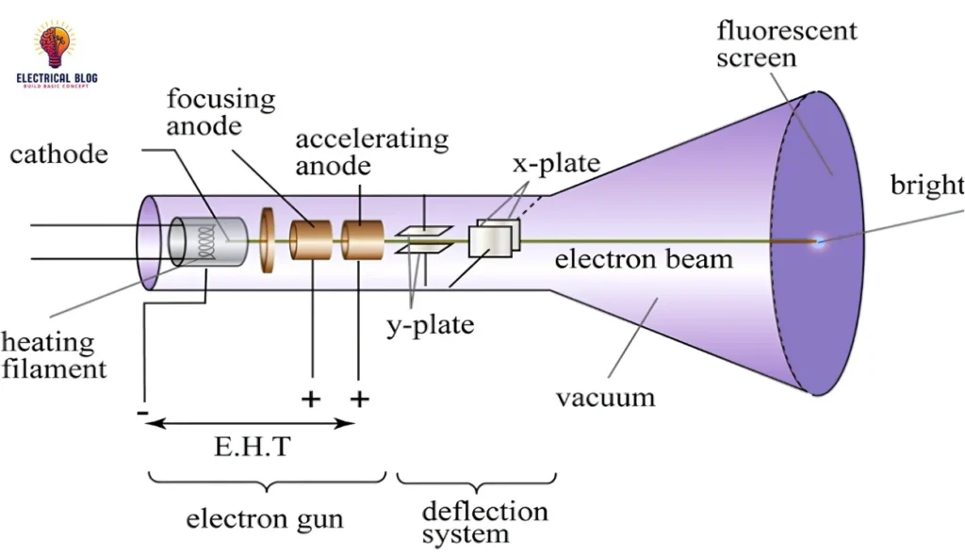
Block Diagram of CRO

Slide 10
Working of CRO:
Vertical Amplifier: It amplifies the input signal for display on the CRT screen.
Delay Line: It provides certain amount of delay to the signal, this delayed signal is applied to vertical deflection plates of CRT.
Trigger Circuit: This produces a triggering signal for synchronizing both horizontal and vertical deflections of electron beam.
Electron Gun: It emits a focused electron beam,accelerates and detects them to the screen, creates a spot or trace on the phosphor screen.
Time base Generator: This produces a sawtooth signal for horizontal deflection of electron beam.
Horizontal Amplifier: It amplifies the sawtooth signal and then connects it to the horizontal deflection plates of CRT.
Power supply: It produces both high and low voltages. The negative high voltage and positive low voltage are applied to CRT and other circuits respectively.
Cathode Ray Tube (CRT): It is the major important block of CRO and mainly consists of four parts. Those are electron gun, vertical deflection plates, horizontal deflection plates and fluorescent screen.The electron beam, which is produced by an electron gun gets deflected in both vertical and horizontal directions by a pair of vertical deflection plates and a pair of horizontal deflection plates respectively. Finally, the deflected beam will appear as a spot on the fluorescent screen.

Slide 11
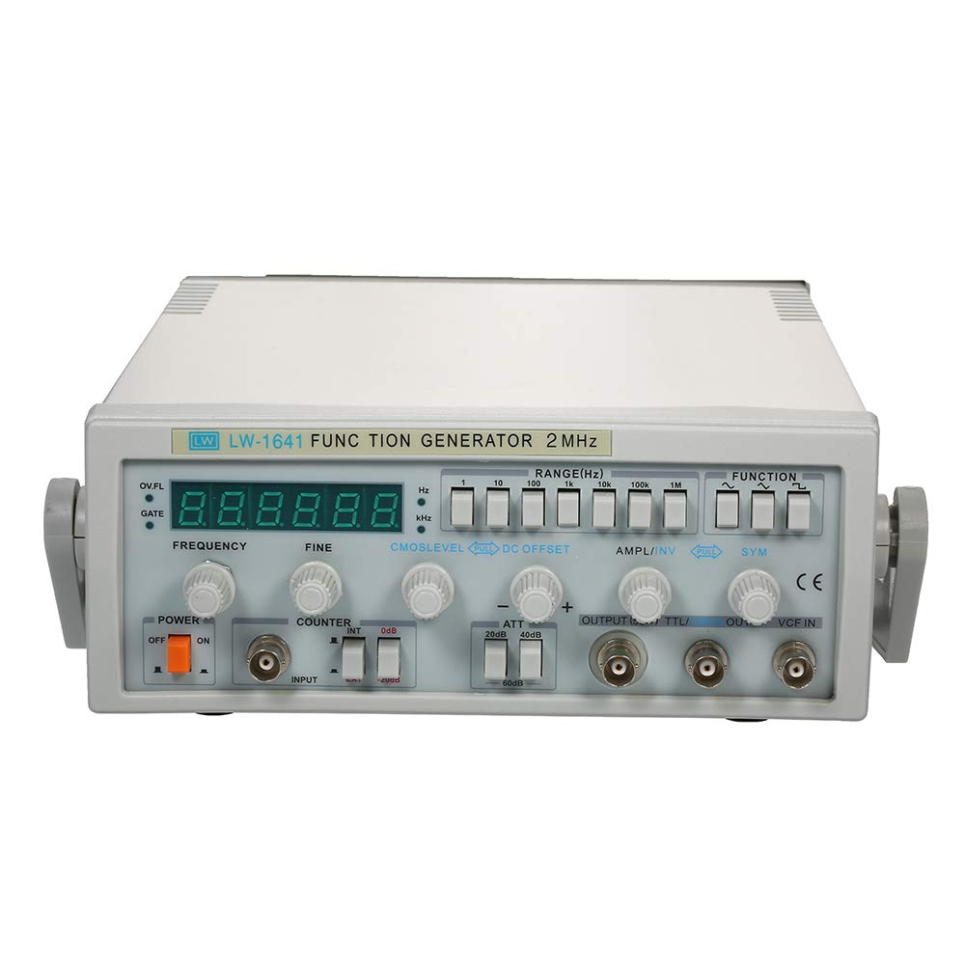
Signal Generator
A signal generator is an electronic device that produces electrical signals with specific characteristics like amplitude, frequency, and waveform.
It can generates sine, square, or triangle wave.

Slide 12
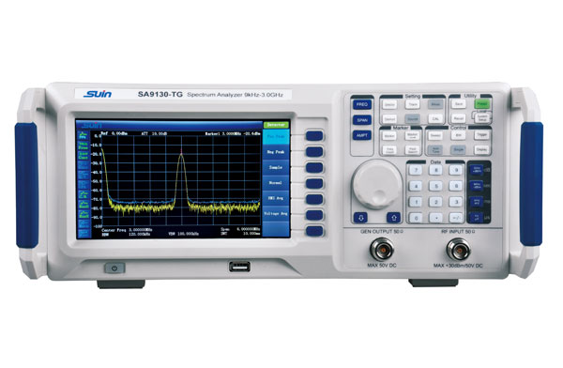
Types of signal generator
Function generator
RF generator
Audio generator and
Pulse generator
Sweep Generator

Slide 13
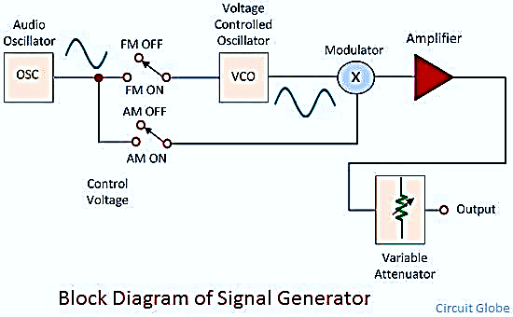
Internal Functions of Signal Generator:

Slide 14
Working principle of signal generator
Oscillator: It generates a repetitive waveform, like a sine wave, square, or triangle wave.
Modulator: The modulator shapes the waveform generated by the oscillator into the desired output. This can involve adding or removing modulation, like amplitude, frequency, or phase modulation (AM, FM, PM).
Frequency Control Circuit: This circuit allows for precise adjustment of the signal's frequency, enabling the generator to produce a wide range of frequencies.
Amplifier: The output signal is amplified to the desired level, ensuring it's strong enough for testing or other applications.
Attenuator: Reduces amplitude for précising output.
Output Stage: Finally, the signal is sent to the device under test .

Slide 15
Thank You

